Slide 1
Sort
DSA

Slide 2
Why we do sorting?
One of the most common programming tasks in computing.
Examples of sorting:
List containing exam scores sorted from Lowest to Highest or from Highest to Lowest
List point pairs of a geometric shape.
List of student records and sorted by student number or alphabetically by first or last name.

Slide 3
Some examples
Sort a list of names.
Organize an MP3 library.
Display Google PageRank results.
List RSS news items in reverse chronological order.
Find the median.
Find the closest pair.
Binary search in a database.
Identify statistical outliers.
Find duplicates in a mailing list.
Data compression.
Computer graphics.
Computational biology.
Supply chain management.
Load balancing on a parallel computer.

Slide 4
Why we do sorting?
Searching for an element in an array will be more efficient. (example: looking for a particular phone number).
It’s always nice to see data in a sorted display. (example: spreadsheet or database application).
Computers sort things fast - therefore it takes the burden off of the user to search a list.

Slide 5
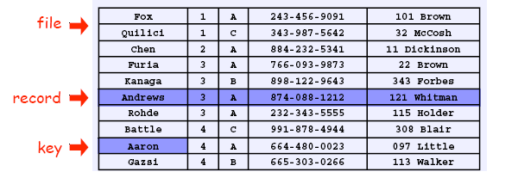
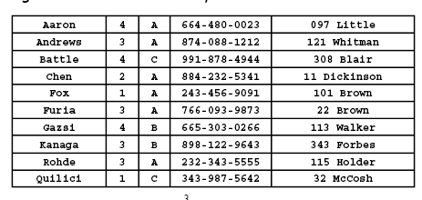
Sort. Rearrange array of N objects into ascending order.

Slide 6
History of Sorting
Sorting is one of the most important operations performed by computers. In the days of magnetic tape storage before modern databases, database updating was done by sorting transactions and merging them with a master file.

Slide 7
History of Sorting
It's still important for presentation of data extracted from databases: most people prefer to get reports sorted into some relevant order before flipping through pages of data!

Slide 8
Insertion
ShellSort
MergeSort
QuickSort
BubbleSort
SelectionSort

Slide 9
Insertion Sort
One of the simplest methods
Consists of N-1 passes

Slide 10
Algorithm
sorting takes place by inserting a particular element at the appropriate position
that’s why the name - insertion sort
N-1 Iterations
In the First iteration, second element A[1] is compared with the first element A[0]
In the second iteration third element is compared with first and second element
In general, within each iteration :
an element is compared with all the elements before it.
while comparing if it is found that the element can be inserted at a suitable position, then space is created for it by shifting the other elements one position up and inserts the desired element at the suitable position.
procedure is repeated for all the elements in the list.

Slide 11
Insertion Sort demo
Iteration | 23 | 21 | 40 | 1 | 33 | 4 | Original Numbers | #Moves
First | 21 | 23 | 40 | 1 | 33 | 4 | Compare 21 with 23. Swapped 21 with 23 | 1
Second | 21 21 | 23 23 | 40 40 | 1 1 | 33 33 | 4 4 | Compare 40 with 23; No need to swap Compare 40 with 21; No need to swap | 0
Third | 21 21 1 | 23 1 21 | 1 23 23 | 40 40 40 | 33 33 33 | 4 4 4 | Compare 1 with 40, Swap Compare 1 with 23, Swap Compare 1 with 21, Swap | 3
Fourth | 1 1 1 1 | 21 21 21 21 | 23 23 23 23 | 33 33 33 33 | 40 40 40 40 | 4 4 4 4 | Compare 33 with 40, Swap Compare 33 with 23 Compare 33 with 21 Compare 33 with 1 | 1
Fifth | 1 1 1 1 1 | 21 21 21 4 4 | 23 23 4 21 21 | 33 4 23 23 23 | 4 33 33 33 33 | 40 40 40 40 40 | Compare 4 with 40, Swap Compare 4 with 33, Swap Compare 4 with 23, Swap Compare 4 with 21, Swap Compare 4 with 1 | 4

Slide 12
Insertion Sort demo
Iteration | 23 | 21 | 40 | 1 | 33 | 4 | Original Numbers | #Moves
1 | 21 | 23 | 40 | 1 | 33 | 4 | Compare 21 with 23. Swapped 21 with 23 | 1
2 | 21 21 | 23 23 | 40 40 | 1 1 | 33 33 | 4 4 | Compare 40 with 23; No need to swap Compare 40 with 21; No need to swap | 0
3 | 21 21 1 | 23 1 21 | 1 23 23 | 40 40 40 | 33 33 33 | 4 4 4 | Compare 1 with 40 Compare 1 with 23 Compare 1 with 21 | 3
4 | 1 1 1 1 | 21 21 21 21 | 23 23 23 23 | 33 33 33 33 | 40 40 40 40 | 4 4 4 4 | Compare 33 with 40 Compare 33 with 23 Compare 33 with 21 Compare 33 with 1 | 1
5 | 1 1 1 1 1 | 21 21 21 4 4 | 23 23 4 21 21 | 33 4 23 23 23 | 4 33 33 33 33 | 40 40 40 40 40 | Compare 4 with 40 Compare 4 with 33 Compare 4 with 23 Compare 4 with 21 Compare 4 with 1 | 4

Slide 13
Insertion sort in daily life
Card sorting during a game of cards
To sort the cards in your hand you extract a card, shift the remaining cards, and then insert the extracted card in the correct place. This process is repeated until all the cards are in the correct sequence

Slide 14
Insertion Sort runtimes
Best case: O(n) It occurs when the data is in sorted order. After making one pass through the data and making no insertions, insertion sort exits.
Average case: Θ(n^2) since there is a wide variation with the running time.
Worst case: O(n^2) if the numbers were sorted in reverse order.

Slide 15
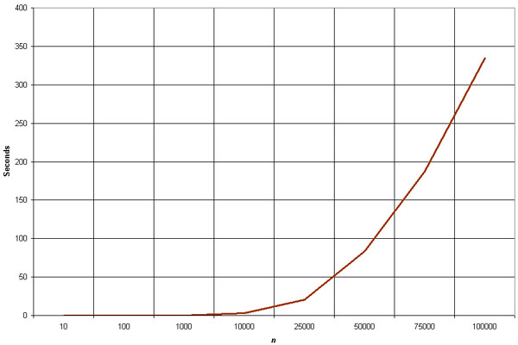
Empirical Analysis of Insertion Sort
The graph demonstrates the n^2 complexity of the insertion sort.
Source: http://linux.wku.edu/~lamonml/algor/sort/insertion.html

Slide 16
Insertion Sort
The insertion sort is a good choice for sorting lists of a few thousand items or less.
Advantage of Insertion Sort is that it is relatively simple and easy to implement.
Disadvantage of Insertion Sort is that it is not efficient to operate with a large list or input size

Slide 17
Merge Sort

Slide 18
Merge Sort
Divide the array at its midpoint
Recursively apply Merge to sort both halves
nLOG(n)

Slide 19
Algo
void mergesort(int lo, int hi)
{
if (lo<hi)
{
int m=(lo+hi)/2;
mergesort(lo, m);
mergesort(m+1, hi);
merge(lo, m, hi);
}
}
index m in the middle between lo and hi is determined.
Then the first part of the sequence (from lo to m) and the second part (from m+1 to hi) are sorted by recursive calls of mergesort.
Then the two sorted halves are merged by procedure merge. Recursion ends when lo = hi,
i.e. when a subsequence consists of only one element.
The main work of the Mergesort algorithm is performed by function merge.
Different possibilities to implement this function

Slide 20
Merge (Straight)
// Straightforward variant
void merge(int lo, int m, int hi)
{
int i, j, k;
// copy both halves of a to auxiliary array b
for (i=lo; i<=hi; i++)
b[i]=a[i];
i=lo; j=m+1; k=lo;
// copy back next-greatest element at each time
while (i<=m && j<=hi)
if (b[i]<=b[j])
a[k++]=b[i++];
else
a[k++]=b[j++];
// copy back remaining elements of first half (if any)
while (i<=m)
a[k++]=b[i++];
}
Copy Array (a) into (b)
Repeat while (I < m and J <= hi)
Copy min(b[i], b[j]) to a[k]
Copy back the remaining (if any) to (b)

Slide 21
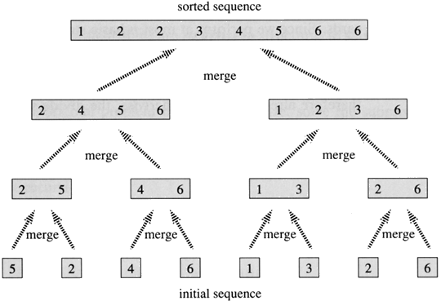

Slide 22
based on the divide-and-conquer
Its worst-case running time has a lower order of growth than insertion sort.
Since we are dealing with subproblems, we state each subproblem as sorting a subarray A[p .. r]. Initially, p = 1 and r = n, but these values change as we recurse through subproblems.
To sort A[p .. r]:
1. Divide Step
If a given array A has zero or one element, simply return; it is already sorted. Otherwise, split A[p .. r] into two subarrays A[p .. q] and A[q + 1 .. r], each containing about half of the elements of A[p .. r]. That is, q is the halfway point of A[p .. r].
2. Conquer Step
Conquer by recursively sorting the two subarrays A[p .. q] and A[q + 1 .. r].
3. Combine Step
Combine the elements back in A[p .. r] by merging the two sorted subarrays A[p .. q] and A[q + 1 .. r] into a sorted sequence. To accomplish this step, we will define a procedure MERGE (A, p, q, r).
Note that the recursion bottoms out when the subarray has just one element, so that it is trivially sorted.

Slide 23
Idea Behind Linear Time Merging
Think of two piles of cards, Each pile is sorted and placed face-up on a table with the smallest cards on top. We will merge these into a single sorted pile, face-down on the table.
Each Basic step (should take constant time, since we check just the two top cards )
Choose the smaller of the two top cards.
Remove it from its pile, thereby exposing a new top card.
Place the chosen card face-down onto the output pile.
Repeatedly perform basic steps until one input pile is empty.
Once one input pile empties, just take the remaining input pile and place it face-down onto the output pile.

Slide 24
MERGE (A, p, q, r )
1. n₁ ← q − p + 1 2. n₂ ← r − q 3. Create arrays L[1 . . n₁ + 1] and R[1 . . n₂ + 1] 4. FOR i ← 1 TO n₁ 5. DO L[i] ← A[p + i − 1] 6. FOR j ← 1 TO n₂ 7. DO R[j] ← A[q + j ] 8. L[n₁ + 1] ← ∞ 9. R[n₂ + 1] ← ∞ 10. i ← 1 11. j ← 1 12. FOR k ← p TO r 13. DO IF L[i ] ≤ R[ j] 14. THEN A[k] ← L[i] 15. i ← i + 1 16. ELSE A[k] ← R[j] 17. j ← j + 1

Slide 25
#define MAX 10
void merge(int list[],int list1[],int k,int m,int n) {
int i,j;
i=k;
j = m+1;
while( i <= m && j <= n) {
if(list[i] <= list[j]) {
list1[k] = list[i];
i++; k++;
} else {
list1[k] = list[j];
j++; k++;
}
}
while(i <= m) {
list1[k] = list[i];
i++; k++;
}
while (i <= n ) {
list1[k] = list[j];
j++; k++;
}
}
void mpass( int list[],int list1[],int l,int n) {
int i;
i = 0;
while( i <= (n-2*l+1)) {
merge(list,list1,i,(i+l-1),(i+2*l-1));
i = i + 2*l;
}
if((i+l-1) < n)
merge(list,list1,i,(i+l-1),n);
else
while (i <= n ) {
list1[i] = list[i];
i++;
}
}
void readlist(int list[],int n) {
int i;
printf("Enter the elements\n");
for(i=0;i<n;i++)
scanf("%d",&list[i]);
}

Slide 26
void printlist(int list[],int n)
{
int i;
printf("The elements of the list are: \n");
for(i=0;i<n;i++)
printf("%d\t",list[i]);
}
void main()
{
int list[MAX], n;
printf("Enter the number of elements in the list max = 10\n");
scanf("%d",&n);
readlist(list,n);
printf("The list before sorting is:\n");
printlist(list,n);
msort(list,n-1);
printf("The list after sorting is:\n");
printlist(list,n);
}

Slide 27
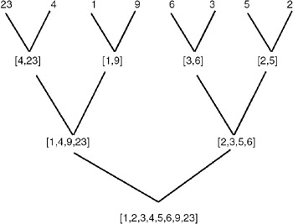

Slide 28
Merging
The key to Merge Sort is merging two sorted lists into one, such that if you have two lists X (x₁≤x₂≤…≤x_{m}) and Y(y₁≤y₂≤…≤y_{n}) the resulting list is Z(z₁≤z₂≤…≤z_{m+n})
Example:
L₁ = { 3 8 9 } L₂ = { 1 5 7 }
merge(L₁, L₂) = { 1 3 5 7 8 9 }

Slide 29
Merging (cont.)
X:
3 | 10 | 23 | 54
Y:
1 | 5 | 25 | 75
Result:

Slide 30
Merging (cont.)
X:
3 | 10 | 23 | 54
Y:
 | 5 | 25 | 75
Result:
1

Slide 31
Merging (cont.)
X:
 | 10 | 23 | 54
Y:
 | 5 | 25 | 75
Result:
1 | 3

Slide 32
Merging (cont.)
X:
 | 10 | 23 | 54
Y:
 |  | 25 | 75
Result:
1 | 3 | 5

Slide 33
Merging (cont.)
X:
 |  | 23 | 54
Y:
 |  | 25 | 75
Result:
1 | 3 | 5 | 10

Slide 34
Merging (cont.)
X:
 |  |  | 54
Y:
 |  | 25 | 75
Result:
1 | 3 | 5 | 10 | 23

Slide 35
Merging (cont.)
X:
 |  |  | 54
Y:
 |  |  | 75
Result:
1 | 3 | 5 | 10 | 23 | 25

Slide 36
Merging (cont.)
X:
Y:
 |  |  | 75
Result:
1 | 3 | 5 | 10 | 23 | 25 | 54

Slide 37
Merging (cont.)
X:
Y:
Result:
1 | 3 | 5 | 10 | 23 | 25 | 54 | 75

Slide 38
Divide And Conquer
Merging a two lists of one element each is the same as sorting them.
Merge sort divides up an unsorted list until the above condition is met and then sorts the divided parts back together in pairs.
Specifically this can be done by recursively dividing the unsorted list in half, merge sorting the right side then the left side and then merging the right and left back together.

Slide 39
Merge Sort Algorithm
Given a list L with a length k:
If k == 1 → the list is sorted
Else:
Merge Sort the left side (0 thru k/2)
Merge Sort the right side (k/2+1 thru k)
Merge the right side with the left side

Slide 40
Merge Sort Example
99 | 6 | 86 | 15 | 58 | 35 | 86 | 4 | 0

Slide 41
Merge Sort Example
99 | 6 | 86 | 15 | 58 | 35 | 86 | 4 | 0
99 | 6 | 86 | 15
58 | 35 | 86 | 4 | 0

Slide 42
Merge Sort Example
99 | 6 | 86 | 15 | 58 | 35 | 86 | 4 | 0
99 | 6 | 86 | 15
58 | 35 | 86 | 4 | 0
99 | 6
86 | 15
58 | 35
86 | 4 | 0

Slide 43
Merge Sort Example
99 | 6 | 86 | 15 | 58 | 35 | 86 | 4 | 0
99 | 6 | 86 | 15
58 | 35 | 86 | 4 | 0
99 | 6
86 | 15
58 | 35
86 | 4 | 0
99
6
86
15
58
35
86
4 | 0

Slide 44
Merge Sort Example
99 | 6 | 86 | 15 | 58 | 35 | 86 | 4 | 0
99 | 6 | 86 | 15
58 | 35 | 86 | 4 | 0
99 | 6
86 | 15
58 | 35
86 | 4 | 0
99
6
86
15
58
35
86
4 | 0
4
0

Slide 45
Merge Sort Example
99
6
86
15
58
35
86
0 | 4
Merge
4
0

Slide 46
Merge Sort Example
6 | 99
15 | 86
58 | 35
0 | 4 | 86
99
6
86
15
58
35
86
0 | 4
Merge

Slide 47
Merge Sort Example
6 | 15 | 86 | 99
0 | 4 | 35 | 58 | 86
6 | 99
15 | 86
58 | 35
0 | 4 | 86
Merge

Slide 48
Merge Sort Example
0 | 4 | 6 | 15 | 35 | 58 | 86 | 86 | 99
6 | 15 | 86 | 99
0 | 4 | 35 | 58 | 86
Merge

Slide 49
Merge Sort Example
0 | 4 | 6 | 15 | 35 | 58 | 86 | 86 | 99

Slide 50
Implementing Merge Sort
There are two basic ways to implement merge sort:
In Place: Merging is done with only the input array
Pro: Requires only the space needed to hold the array
Con: Takes longer to merge because if the next element is in the right side then all of the elements must be moved down.
Double Storage: Merging is done with a temporary array of the same size as the input array.
Pro: Faster than In Place since the temp array holds the resulting array until both left and right sides are merged into the temp array, then the temp array is appended over the input array.
Con: The memory requirement is doubled

Slide 51
Merge Sort Analysis
The Double Memory Merge Sort runs O (N log N) for all cases, because of its Divide and Conquer approach.
T(N) = 2T(N/2) + N = O(N logN)
(i.e.) Best Case, Average Case, and Worst Case = O(N logN)

Slide 52
Shell Sort

Slide 53
Shell Sort
Invented by Donald Shell in 1959.
1st algorithm to break the quadratic time barrier but few years later, a sub quadratic time bound was proven
Shellsort works by comparing elements that are distant rather than adjacent elements in an array.
Shellsort uses a sequence h₁, h₂, …, h_{t} called the increment sequence. Any increment sequence is fine as long as h₁ = 1 and some other choices are better than others
Shellsort improves on the efficiency of insertion sort by quickly shifting values to their destination

Slide 54
Shell Sort
Improves on insertion sort.
Starts by comparing elements far apart, then elements less far apart, and finally comparing adjacent elements (effectively an insertion sort).
By this stage the elements are sufficiently sorted that the running time of the final stage is much closer to O(N) than O(N²).

Slide 55
Principle
arrange the data sequence in a two-dimensional array
sort the columns of the array
The effect is that the data sequence is partially sorted. The process above is repeated, but each time with a narrower array, i.e. with a smaller number of columns. In the last step, the array consists of only one column

Slide 56
Shell Sort
Step 1: divide the original list into smaller lists.
Step 2: sort individual sub lists using any known sorting algorithm (like bubble sort, insertion sort, selection sort, etc).

Slide 57
Shell Sort - Parameters
how should I divide the list? Which sorting algorithm to use? How many times I will have to execute steps 1 and 2? And the most puzzling question if I am anyway using bubble, insertion or selection sort then how I can achieve improvement in efficiency?
For dividing the original list into smaller lists, we choose a value K, which is known as increment. Based on the value of K, we split the list into K sub lists.
For example, if our original list is x[0], x[1], x[2], x[3], x[4]….x[99] and we choose 5 as the value for increment, K then we get the following sub lists.
first_list = x[0], x[5], x[10], x[15]…….x[95]
second_list =x[1], x[6], x[11], x[16]…….x[96]
third_list =x[2], x[7], x[12], x[17]…….x[97]
forth_list =x[3], x[8], x[13], x[18]…….x[98]
fifth_list =x[4], x[9], x[14], x[19] …….x[99]
So the ith sub list will contain every Kth element of the original list starting from index i-1.

Slide 58
Shell Sort
In-place sort
O(nLog(n))
Spacing dependent
Start with large and converge into small ultimately 1
Formal analysis is difficult
Arriving at Optimal spacing values – difficult to analyze
Since for every iteration we are decreasing the value of the increment (K) the algorithm is also known as “diminishing increment sort”.

Slide 59
Shellsort Example
Sort: 18 32 12 5 38 33 16 2
8 Numbers to be sorted, Shell’s increment will be floor(n/2)
* floor(8/2) ➔ floor(4) = 4
increment 4:
1 2 3 4
18 32 12 5 38 33 16 2
Step 1) Only look at 18 and 38 and sort in order ;
18 and 38 stays at its current position because they are in order.
Step 2) Only look at 32 and 33 and sort in order ;
32 and 33 stays at its current position because they are in order.
Step 3) Only look at 12 and 16 and sort in order ;
12 and 16 stays at its current position because they are in order.
Step 4) Only look at 5 and 2 and sort in order ;
2 and 5 need to be switched to be in order.

Slide 60
Shellsort Example (con’t)
Sort: 18 32 12 5 38 33 16 2
Resulting numbers after increment 4 pass:
18 32 12 2 38 33 16 5
* floor(4/2) ➔ floor(2) = 2
increment 2:
1 2
18 32 12 2 38 33 16 5
Step 1) Look at 18, 12, 38, 16 and sort them in their appropriate location:
12 32 16 2 18 33 38 5
Step 2) Look at 32, 2, 33, 5 and sort them in their appropriate location:
12 2 16 5 18 32 38 33

Slide 61
Shellsort Example (con’t)
Sort: 18 32 12 5 38 33 16 2
* floor(2/2) ➔ floor(1) = 1
increment 1:
1
12 2 16 5 18 32 38 33
2 5 12 16 18 32 33 38
The last increment or phase of Shellsort is basically an Insertion
Sort algorithm.

Slide 62
Ad
Advantages
efficient for medium size lists.
For bigger lists, the algorithm is not the best choice. Fastest of all O(N^2) sorting algorithms.
5 times faster than the bubble sort and a little over twice as fast as the insertion sort, its closest competitor.
Disadvantages
it is a complex algorithm and its not nearly as efficient as the merge, heap, and quick sorts.
The shell sort is still significantly slower than the merge, heap, and quick sorts, but its relatively simple algorithm makes it a good choice for sorting lists of less than 5000 items unless speed important. It's also an excellent choice for repetitive sorting of smaller lists.

Slide 63
Best Case
Shell Sort best case is when the array is already sorted in the right order and number are elements are large. The number of comparisons is less

Slide 64
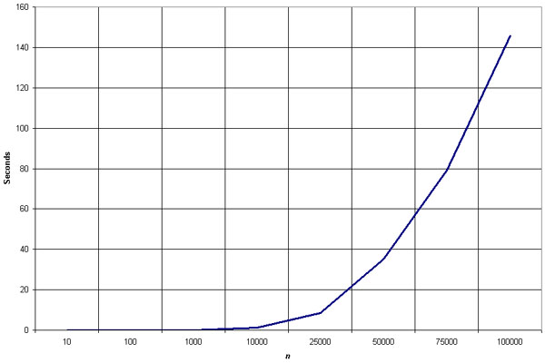
Empirical Analysis of Shellsort

Slide 65
Example
2 | 23 | 1 | 4 | 5 | 6 | 8 | 10 | 12 | 18
2 | 23 | 1 | 4
5 | 6 | 8 | 10
12 | 18
2 | 23 | 1 | 4
5 | 6 | 8 | 10
12 | 18
2 | 6 | 1
4 | 5 | 18
8 | 10 | 12
23
2 | 5 | 1
4 | 6 | 12
8 | 10 | 18
23
2 | 5
1 | 4
6 | 12
8 | 10
18 | 23
1 | 4
2 | 5
6 | 10
8 | 12
18 | 23

Slide 66
Increment sequence (h1, h2, … hk)

Slide 67
Quick Sort

Slide 68
Quicksort
Efficient sorting algorithm
Discovered by C.A.R. Hoare
Example of Divide and Conquer algorithm
Two phases
Partition phase
Divides the work into half
Sort phase
Conquers the halves!

Slide 69
Quick Sort
Quicksort sorts a list based on the divide and conquer strategy.
Divide the list into two sub-lists, sort these sub-lists and recursively until the list is sorted; The basic steps of quicksort algorithm are as follows:
Choose a key element in the list which is called a pivot.
Reorder the list with the rule that all elements which are less than the pivot come before the pivot and so that all elements greater than the pivot come after it. After the partitioning, the pivot is in its final position.
Recursively reorder two sub-lists: the sub-list of lesser elements and the sub-list of greater elements.

Slide 70
Algo
QuickSort (Set) {
IF Set contains 1 element, return (Set)
Choose a Pivot from Set
Let S1, S2, S3 be the sequences of elements in Set such that they are LESS THAN, EQUAL TO and MORE THAN the Pivot, respectively
Return QuickSort(S1), followed by S2 followed by QuickSort(S3)
}

Slide 71
Example
We are given array of n integers to sort:
40
20
10
80
60
50
7
30
100

Slide 72
Pick Pivot Element
There are a number of ways to pick the pivot element. In this example, we will use the first element in the array:
40
20
10
80
60
50
7
30
100

Slide 73
Partitioning Array
Given a pivot, partition the elements of the array such that the resulting array consists of:
One sub-array that contains elements >= pivot
Another sub-array that contains elements < pivot
The sub-arrays are stored in the original data array.
Partitioning loops through, swapping elements below/above pivot.

Slide 74
pivot_index = 0
40
20
10
80
60
50
7
30
100
[0] [1] [2] [3] [4] [5] [6] [7] [8]
LEFT
RIGHT

Slide 75
While data[LEFT] <= data[pivot]
++LEFT
pivot_index = 0
40
20
10
80
60
50
7
30
100
[0] [1] [2] [3] [4] [5] [6] [7] [8]
LEFT
RIGHT

Slide 76
While data[LEFT] <= data[pivot]
++LEFT
pivot_index = 0
40
20
10
80
60
50
7
30
100
LEFT
RIGHT

Slide 77
While data[LEFT] <= data[pivot]
++LEFT
pivot_index = 0
40
20
10
80
60
50
7
30
100
LEFT
RIGHT

Slide 78
While data[LEFT] <= data[pivot]
++LEFT
While data[RIGHT] > data[pivot]
--RIGHT
pivot_index = 0
40
20
10
80
60
50
7
30
100
[0] [1] [2] [3] [4] [5] [6] [7] [8]
LEFT
RIGHT

Slide 79
While data[LEFT] <= data[pivot]
++LEFT
While data[RIGHT] > data[pivot]
--RIGHT
pivot_index = 0
40
20
10
80
60
50
7
30
100
LEFT
RIGHT

Slide 80
While data[LEFT] <= data[pivot]
++LEFT
While data[RIGHT] > data[pivot]
--RIGHT
If LEFT < RIGHT
swap data[LEFT] and data[RIGHT]
pivot_index = 0
40
20
10
80
60
50
7
30
100
LEFT
RIGHT

Slide 81
While data[LEFT] <= data[pivot]
++LEFT
While data[RIGHT] > data[pivot]
--RIGHT
If LEFT < RIGHT
swap data[LEFT] and data[RIGHT]
pivot_index = 0
40
20
10
30
60
50
7
80
100
LEFT
RIGHT

Slide 82
While data[LEFT] <= data[pivot]
++LEFT
While data[RIGHT] > data[pivot]
--RIGHT
If LEFT < RIGHT
swap data[LEFT] and data[RIGHT]
While RIGHT > LEFT, go to 1.
pivot_index = 0
40
20
10
30
60
50
7
80
100
[0] [1] [2] [3] [4] [5] [6] [7] [8]
LEFT
RIGHT

Slide 83
While data[LEFT] <= data[pivot]
++LEFT
While data[RIGHT] > data[pivot]
--RIGHT
If LEFT < RIGHT
swap data[LEFT] and data[RIGHT]
While RIGHT > LEFT, go to 1.
pivot_index = 0
40
20
10
30
60
50
7
80
100
[0] [1] [2] [3] [4] [5] [6] [7] [8]
LEFT
RIGHT

Slide 84
While data[LEFT] <= data[pivot]
++LEFT
While data[RIGHT] > data[pivot]
--RIGHT
If LEFT < RIGHT
swap data[LEFT] and data[RIGHT]
While RIGHT > LEFT, go to 1.
pivot_index = 0
40
20
10
30
60
50
7
80
100
[0] [1] [2] [3] [4] [5] [6] [7] [8]
LEFT
RIGHT

Slide 85
While data[LEFT] <= data[pivot]
++LEFT
While data[RIGHT] > data[pivot]
--RIGHT
If LEFT < RIGHT
swap data[LEFT] and data[RIGHT]
While RIGHT > LEFT, go to 1.
pivot_index = 0
40
20
10
30
60
50
7
80
100
[0] [1] [2] [3] [4] [5] [6] [7] [8]
LEFT
RIGHT

Slide 86
While data[LEFT] <= data[pivot]
++LEFT
While data[RIGHT] > data[pivot]
--RIGHT
If LEFT < RIGHT
swap data[LEFT] and data[RIGHT]
While RIGHT > LEFT, go to 1.
pivot_index = 0
40
20
10
30
60
50
7
80
100
[0] [1] [2] [3] [4] [5] [6] [7] [8]
LEFT
RIGHT

Slide 87
While data[LEFT] <= data[pivot]
++LEFT
While data[RIGHT] > data[pivot]
--RIGHT
If LEFT < RIGHT
swap data[LEFT] and data[RIGHT]
While RIGHT > LEFT, go to 1.
pivot_index = 0
40
20
10
30
60
50
7
80
100
[0] [1] [2] [3] [4] [5] [6] [7] [8]
LEFT
RIGHT

Slide 88
While data[LEFT] <= data[pivot]
++LEFT
While data[RIGHT] > data[pivot]
--RIGHT
If LEFT < RIGHT
swap data[LEFT] and data[RIGHT]
While RIGHT > LEFT, go to 1.
pivot_index = 0
40
20
10
30
7
50
60
80
100
[0] [1] [2] [3] [4] [5] [6] [7] [8]
LEFT
RIGHT

Slide 89
While data[LEFT] <= data[pivot]
++LEFT
While data[RIGHT] > data[pivot]
--RIGHT
If LEFT < RIGHT
swap data[LEFT] and data[RIGHT]
While RIGHT > LEFT, go to 1.
pivot_index = 0
40
20
10
30
7
50
60
80
100
[0] [1] [2] [3] [4] [5] [6] [7] [8]
LEFT
RIGHT

Slide 90
While data[LEFT] <= data[pivot]
++LEFT
While data[RIGHT] > data[pivot]
--RIGHT
If LEFT < RIGHT
swap data[LEFT] and data[RIGHT]
While RIGHT > LEFT, go to 1.
pivot_index = 0
40
20
10
30
7
50
60
80
100
[0] [1] [2] [3] [4] [5] [6] [7] [8]
LEFT
RIGHT

Slide 91
While data[LEFT] <= data[pivot]
++LEFT
While data[RIGHT] > data[pivot]
--RIGHT
If LEFT < RIGHT
swap data[LEFT] and data[RIGHT]
While RIGHT > LEFT, go to 1.
pivot_index = 0
40
20
10
30
7
50
60
80
100
[0] [1] [2] [3] [4] [5] [6] [7] [8]
LEFT
RIGHT

Slide 92
While data[LEFT] <= data[pivot]
++LEFT
While data[RIGHT] > data[pivot]
--RIGHT
If LEFT < RIGHT
swap data[LEFT] and data[RIGHT]
While RIGHT > LEFT, go to 1.
pivot_index = 0
40
20
10
30
7
50
60
80
100
[0] [1] [2] [3] [4] [5] [6] [7] [8]
LEFT
RIGHT

Slide 93
While data[LEFT] <= data[pivot]
++LEFT
While data[RIGHT] > data[pivot]
--RIGHT
If LEFT < RIGHT
swap data[LEFT] and data[RIGHT]
While RIGHT > LEFT, go to 1.
pivot_index = 0
40
20
10
30
7
50
60
80
100
[0] [1] [2] [3] [4] [5] [6] [7] [8]
LEFT
RIGHT

Slide 94
While data[LEFT] <= data[pivot]
++LEFT
While data[RIGHT] > data[pivot]
--RIGHT
If LEFT < RIGHT
swap data[LEFT] and data[RIGHT]
While RIGHT > LEFT, go to 1.
pivot_index = 0
40
20
10
30
7
50
60
80
100
[0] [1] [2] [3] [4] [5] [6] [7] [8]
LEFT
RIGHT

Slide 95
While data[LEFT] <= data[pivot]
++LEFT
While data[RIGHT] > data[pivot]
--RIGHT
If LEFT < RIGHT
swap data[LEFT] and data[RIGHT]
While RIGHT > LEFT, go to 1.
pivot_index = 0
40
20
10
30
7
50
60
80
100
[0] [1] [2] [3] [4] [5] [6] [7] [8]
LEFT
RIGHT

Slide 96
While data[LEFT] <= data[pivot]
++LEFT
While data[RIGHT] > data[pivot]
--RIGHT
If LEFT < RIGHT
swap data[LEFT] and data[RIGHT]
While RIGHT > LEFT, go to 1.
pivot_index = 0
40
20
10
30
7
50
60
80
100
[0] [1] [2] [3] [4] [5] [6] [7] [8]
LEFT
RIGHT

Slide 97
While data[LEFT] <= data[pivot]
++LEFT
While data[RIGHT] > data[pivot]
--RIGHT
If LEFT < RIGHT
swap data[LEFT] and data[RIGHT]
While RIGHT > LEFT, go to 1.
Swap data[RIGHT] and data[pivot_index]
pivot_index = 0
40
20
10
30
7
50
60
80
100
[0] [1] [2] [3] [4] [5] [6] [7] [8]
LEFT
RIGHT

Slide 98
While data[LEFT] <= data[pivot]
++LEFT
While data[RIGHT] > data[pivot]
--RIGHT
If LEFT < RIGHT
swap data[LEFT] and data[RIGHT]
While RIGHT > LEFT, go to 1.
Swap data[RIGHT] and data[pivot_index]
7
20
10
30
40
50
60
80
100
pivot_index = 4
[0] [1] [2] [3] [4] [5] [6] [7] [8]
LEFT
RIGHT

Slide 99
Partition Result
7
20
10
30
40
50
60
80
100
<= data[pivot]
> data[pivot]

Slide 100
Recursion: Quicksort Sub-arrays
7
20
10
30
40
50
60
80
100
<= data[pivot]
> data[pivot]

Slide 101
Two Critical steps
Picking up the right value for Pivot
Partitioning

Slide 102
Picking up the Pivot
Use the first element as pivot
if the input is random, ok
if the input is presorted (or in reverse order)
all the elements go into S2 (or S1)
this happens consistently throughout the recursive calls
Results in O(n²) behavior (Analyze this case later)
Choose the pivot randomly
generally safe
random number generation can be expensive

Slide 103
A better Pivot
Use the median of the array
Partitioning always cuts the array into roughly half
An optimal quicksort (O(N log N))
However, hard to find the exact median (chicken-egg?)
e.g., sort an array to pick the value in the middle
Approximation to the exact median: …

Slide 104
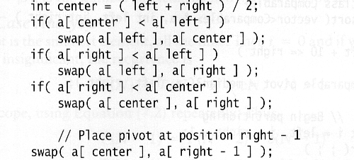
Median of three
We will use median of three
Compare just three elements: the leftmost, rightmost and center
Swap these elements if necessary so that
A[left] = Smallest
A[right] = Largest
A[center] = Median of three
Pick A[center] as the pivot
Swap A[center] and A[right – 1] so that pivot is at second last position (why?)
median3

Slide 105
In-Place Partition
If use additional array (not in-place) like MergeSort
Straightforward to code like MergeSort (write it down!)
Inefficient!
Many ways to implement
Even the slightest deviations may cause surprisingly bad results.
Not stable as it does not preserve the ordering of the identical keys.
Hard to write correctly ☹

Slide 106
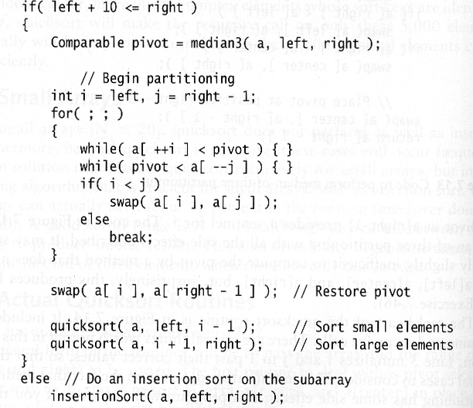
A practical implementation
Choose pivot
Partitioning
Recursion
For small arrays

Slide 107
Quicksort Analysis
Assume that keys are random, uniformly distributed.
What is best case running time?
Recursion:
Partition splits array in two sub-arrays of size n/2
Quicksort each sub-array

Slide 108
Quicksort Analysis
Assume that keys are random, uniformly distributed.
Best case running time: O(n log₂n)
Worst case running time: O(n²)!!!
What can we do to avoid worst case?

Slide 109
Improved Pivot Selection
Pick median value of three elements from data array:
data[0], data[n/2], and data[n-1].
Use this median value as pivot.

Slide 110
Performance
Quicksort turns out to be the fastest sorting algorithm in practice. It has a time complexity of Θ(n log(n)) on the average. However, in the (very rare) worst case quicksort is as slow as Bubble-sort, namely in Θ(n²). There are sorting algorithms with a time complexity of O(n log(n)) even in the worst case,
e.g. Heapsort and Mergesort. But on the average, these algorithms are by a constant factor slower than quicksort.

Slide 111
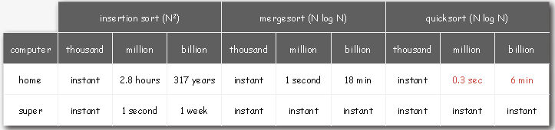
Performance

Slide 112
Quicksort – Summary
Partition
Choose a pivot
Find the position for the pivot so that
all elements to the left are less
all elements to the right are greater
< pivot
pivot
> pivot

Slide 113
Quicksort
Conquer
Apply the same algorithm to each half
< pivot
> pivot
< p’
p’
> p’
pivot
< p”
p”
> p”

Slide 114
Quicksort
Implementation
quicksort( void *a, int low, int high )
{
int pivot;
/* Termination condition! */
if ( high > low )
{
pivot = partition( a, low, high );
quicksort( a, low, pivot-1 );
quicksort( a, pivot+1, high );
}
}
Divide
Conquer

Slide 115
Quicksort - Partition
int partition(int *a, int low, int high) {
int left, right;
int pivot_item;
pivot_item = a[low];
pivot = left = low;
right = high;
while ( left < right ) {
/* Move left while item < pivot */
while( a[left] <= pivot_item ) left++;
/* Move right while item > pivot */
while( a[right] >= pivot_item ) right--;
if ( left < right ) SWAP(a,left,right);
}
/* right is final position for the pivot */
a[low] = a[right];
a[right] = pivot_item;
return right;
}

Slide 116
Quicksort - Partition
int partition( int *a, int low, int high ) {
int left, right;
int pivot_item;
pivot_item = a[low];
pivot = left = low;
right = high;
while ( left < right ) {
/* Move left while item < pivot */
while( a[left] <= pivot_item ) left++;
/* Move right while item > pivot */
while( a[right] >= pivot_item ) right--;
if ( left < right ) SWAP(a,left,right);
}
/* right is final position for the pivot */
a[low] = a[right];
a[right] = pivot_item;
return right;
}
Any item will do as the pivot,
choose the leftmost one!
23
12
15
38
42
18
36
29
27
low
high

Slide 117
Quicksort - Partition
int partition( int *a, int low, int high ) {
int left, right;
int pivot_item;
pivot_item = a[low];
pivot = left = low;
right = high;
while ( left < right ) {
/* Move left while item < pivot */
while( a[left] <= pivot_item ) left++;
/* Move right while item > pivot */
while( a[right] >= pivot_item ) right--;
if ( left < right ) SWAP(a,left,right);
}
/* right is final position for the pivot */
a[low] = a[right];
a[right] = pivot_item;
return right;
}
Set left and right markers
left
right
23
12
15
38
42
18
36
29
27
low
pivot: 23
high

Slide 118
Quicksort - Partition
int partition( int *a, int low, int high ) {
int left, right;
int pivot_item;
pivot_item = a[low];
pivot = left = low;
right = high;
while ( left < right ) {
/* Move left while item < pivot */
while( a[left] <= pivot_item ) left++;
/* Move right while item > pivot */
while( a[right] >= pivot_item ) right--;
if ( left < right ) SWAP(a,left,right);
}
/* right is final position for the pivot */
a[low] = a[right];
a[right] = pivot_item;
return right;
}
Move the markers
until they cross over
left
right
23
12
15
38
42
18
36
29
27
low
pivot: 23
high

Slide 119
Quicksort - Partition
int partition( int *a, int low, int high ) {
int left, right;
int pivot_item;
pivot_item = a[low];
pivot = left = low;
right = high;
while ( left < right ) {
/* Move left while item < pivot */
while( a[left] <= pivot_item ) left++;
/* Move right while item > pivot */
while( a[right] >= pivot_item ) right--;
if ( left < right ) SWAP(a,left,right);
}
/* right is final position for the pivot */
a[low] = a[right];
a[right] = pivot_item;
return right;
}
Move the left pointer while
it points to items <= pivot
left
right
Move right
similarly
23
12
15
38
42
18
36
29
27
low
pivot: 23
high

Slide 120
Quicksort - Partition
int partition( int *a, int low, int high ) {
int left, right;
int pivot_item;
pivot_item = a[low];
pivot = left = low;
right = high;
while ( left < right ) {
/* Move left while item < pivot */
while( a[left] <= pivot_item ) left++;
/* Move right while item > pivot */
while( a[right] >= pivot_item ) right--;
if ( left < right ) SWAP(a,left,right);
}
/* right is final position for the pivot */
a[low] = a[right];
a[right] = pivot_item;
return right;
}
Swap the two items
on the wrong side of the pivot
left
right
23
12
15
38
42
18
36
29
27
pivot: 23
low
high

Slide 121
Quicksort - Partition
int partition( int *a, int low, int high ) {
int left, right;
int pivot_item;
pivot_item = a[low];
pivot = left = low;
right = high;
while ( left < right ) {
/* Move left while item < pivot */
while( a[left] <= pivot_item ) left++;
/* Move right while item > pivot */
while( a[right] >= pivot_item ) right--;
if ( left < right ) SWAP(a,left,right);
}
/* right is final position for the pivot */
a[low] = a[right];
a[right] = pivot_item;
return right;
}
left and right
have swapped over,
so stop
right
left
23
12
15
18
42
38
36
29
27
low
pivot: 23
high

Slide 122
Quicksort - Partition
int partition( int *a, int low, int high ) {
int left, right;
int pivot_item;
pivot_item = a[low];
pivot = left = low;
right = high;
while ( left < right ) {
/* Move left while item < pivot */
while( a[left] <= pivot_item ) left++;
/* Move right while item > pivot */
while( a[right] >= pivot_item ) right--;
if ( left < right ) SWAP(a,left,right);
}
/* right is final position for the pivot */
a[low] = a[right];
a[right] = pivot_item;
return right;
}
right
left
23
12
15
18
42
38
36
29
27
low
pivot: 23
high
Finally, swap the pivot
and right

Slide 123
Quicksort - Partition
int partition( int *a, int low, int high ) {
int left, right;
int pivot_item;
pivot_item = a[low];
pivot = left = low;
right = high;
while ( left < right ) {
/* Move left while item < pivot */
while( a[left] <= pivot_item ) left++;
/* Move right while item > pivot */
while( a[right] >= pivot_item ) right--;
if ( left < right ) SWAP(a,left,right);
}
/* right is final position for the pivot */
a[low] = a[right];
a[right] = pivot_item;
return right;
}
right
pivot: 23
18
12
15
23
42
38
36
29
27
low
high
Return the position
of the pivot

Slide 124
Quicksort - Conquer
pivot
pivot: 23
18
12
15
23
42
38
36
29
27
Recursively
sort left half
Recursively
sort right half

Slide 125
Quicksort - Analysis
Partition
Check every item once O(n)
Conquer
Divide data in half O(log₂n)
Total
Product O(n log n)
Same as Heapsort
quicksort is generally faster
Fewer comparisons
Details later (and assignment 2!)
But there’s a catch …………….

Slide 126
Quicksort - The truth!
What happens if we use quicksort on data that’s already sorted (or nearly sorted)
We’d certainly expect it to perform well!

Slide 127
Bubble Sort

Slide 128
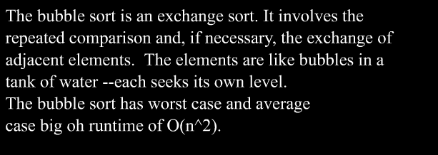
Bubble

Slide 129
Bubble sort
Works by repeatedly stepping through the list to be sorted, comparing two items at a time and swapping them if they are in the wrong order. The pass through the list is repeated until no swaps are needed, which indicates that the list is sorted.
Sort: 34 8 64 51 32 21
Pass 1
34 8 64 51 32 21
8 34 64 51 32 21
8 34 51 64 32 21
8 34 51 32 64 21
8 34 51 32 21 64
Pass 2
8 34 51 32 21 64
8 34 51 32 21 64
8 34 51 32 21 64
8 34 32 51 21 64
8 34 32 21 51 64
8 34 32 21 51 64
Worst and average - O(n^2)
Not practical for list with large n - except when list is very close to sorted
Repeat until no swaps are made.

Slide 130
Algo
In bubble sort, the larger bubbles (higher values) bubble up displacing the smaller bubbles (lower values)
procedure bubbleSort(A : list of sortable items)
repeat
swapped = false
for i = 1 to length(A) - 1 {
if A[i-1] > A[i] {
swap(A[i-1], A[i])
swapped = true
}
}
until not swapped /*repeat until no element has been swapped*/
end procedure

Slide 131
Algo - optimized
Can be optimized further
Final element can be ignored in each iteration
Nth pass finds the largest element and puts in place, so need not be compared
All elements after the last swap have been sorted

Slide 132
Selection Sort
works by selecting the smallest (or largest) element of the array and placing it at the head of the array
Then the process is repeated for the remainder of the array; the next largest element is selected and put into the next slot, and so on down the line

Slide 133
Selection Sort
Repeatedly searches for the largest value in a section of the data
Moves that value into its correct position in a sorted section of the list
Uses the Find Largest algorithm

Slide 134
Selection Sort
1. Get values for n and the n list items
2. Set the marker for the unsorted section at the end of the list
3. While the unsorted section of the list is not empty, do steps 4 through 6
4. Select the largest number in the unsorted section of the list
Exchange this number with the last number in the unsorted
section of the list
6. Move the marker for the unsorted section left one position
7. Stop

Slide 135
Selection Sort
Count comparisons of largest so far against other values
Find Largest, given m values, does m-1 comparisons
Selection sort calls Find Largest n times,
Each time with a smaller list of values
Cost = n-1 + (n-2) + … + 2 + 1 = n(n-1)/2

Slide 136
Selection Sort
Time efficiency
Comparisons: n(n-1)/2
Exchanges: n (swapping largest into place)
Overall: Θ(n²), best and worst cases
Space efficiency
Space for the input sequence, plus a constant number of local variables

Slide 137
Selection Sort
Sort: 34 8 64 51 32 21
34 8 64 51 32 21
Set marker at 21 and search for largest
34 8 21 51 32 64
34-32 is considered unsorted list
34 8 21 32 51 64
Repeat this process until unsorted list is empty
32 8 21 34 51 64
21 8 32 34 51 64
8 21 32 34 51 64
^
^
^

Slide 138
Selection Sort
Quadratic sorting algo
Searches all elements until it finds the smallest
Swaps this with the 1st element of the list
Repeats with the remaining elements swaps with the next element
O(n2)
Does not depend on the values of the list

Slide 139
Selection Sort
for(int x=0; x<n; x++) {
int index_of_min = x;
for(int y=x; y<n; y++) {
if(array[index_of_min]>array[y]) {
index_of_min = y;
}
}
int temp = array[x];
array[x] = array[index_of_min];
array[index_of_min] = temp;
}

Slide 140
Comparison of all sorts

Slide 141
Insertion, selection and bubble sort have quadratic worst-case performance
The faster comparison based algorithm ?
O(nlogn)
Mergesort and Quicksort

Slide 142
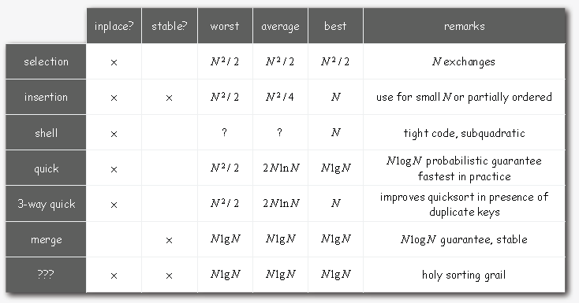
Summary

